Slide 1
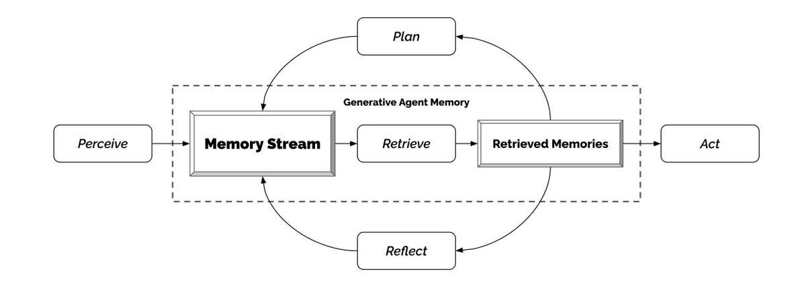
Vector Databases: Memory for Your AI
Unlike traditional SQL databases that store text or numbers in rows, Vector Databases store data as high-dimensional embeddings.
Tools like ChromaDB (local/open-source) and Pinecone (cloud-scale) allow for lightning-fast retrieval of related data.
This is the "hard drive" where you store your local PDFs, spreadsheets, and private documents.

Slide 2
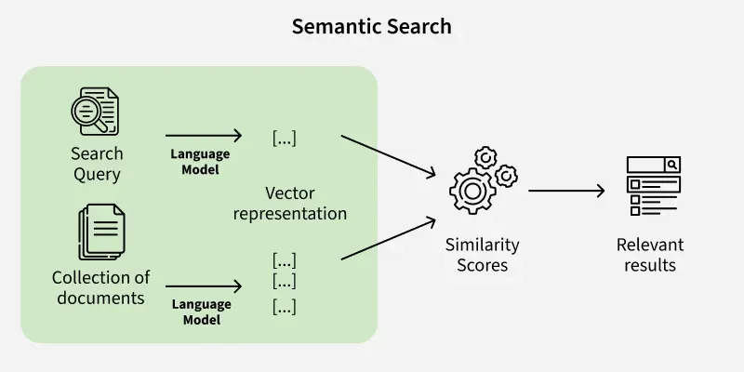
Semantic Search: Finding Meaning, Not Just Words
Traditional search looks for exact keywords. Semantic Search uses embeddings to find the "relevant" page based on the meaning of the user's query.
By converting the user's question into a vector, the system can find the exact paragraph in a 500-page PDF that contains the answer.
This step acts as a "filter" to ensure the LLM only reads the necessary information.

Slide 3
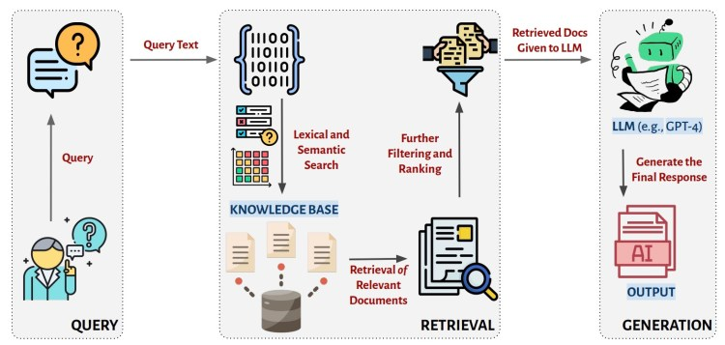
RAG Pipelines: Eliminating Hallucinations
A RAG Pipeline follows a three-step process: Retrieve (find context), Augment (add context to the prompt), and Generate (ask the LLM).
This "Chat with your Data" approach ensures the LLM bases its answers on factual local data rather than its own internal training memory.
It is the industry standard for creating reliable, private, and up-to-date AI assistants.

